Slide 1
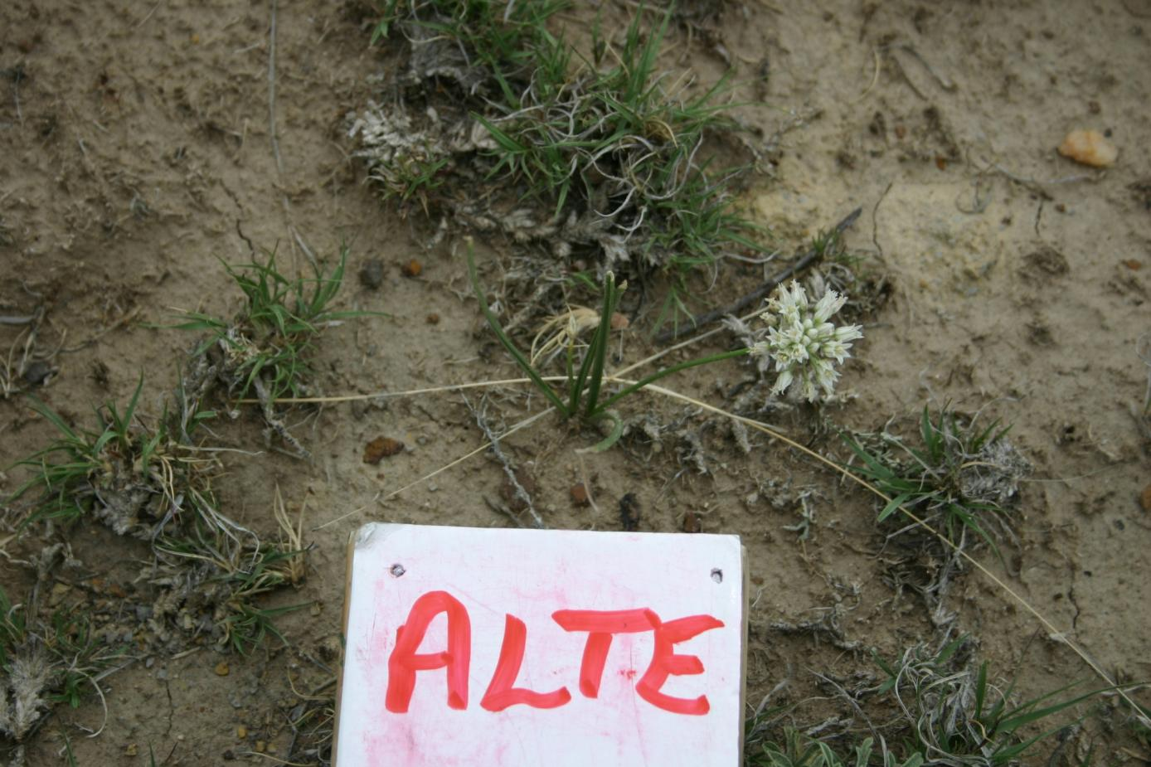
FORBS
Allium textile

Slide 2
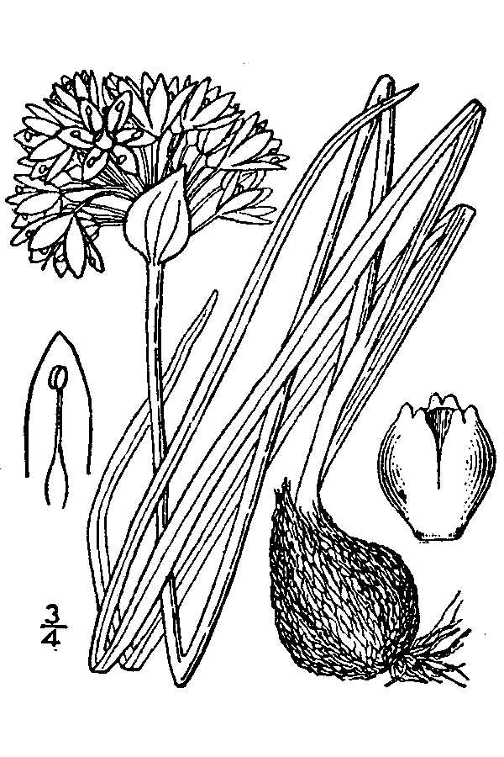
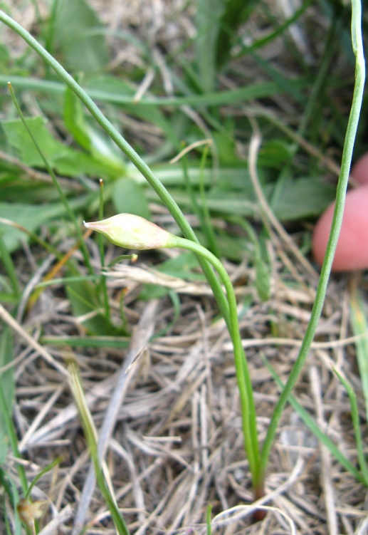
nearly round stem; smells of onion,
can be confused with LEMO, but very
different flowers and LEMO lvs are
grass-like.
ALTE – Allium textile – textile onion

Slide 3
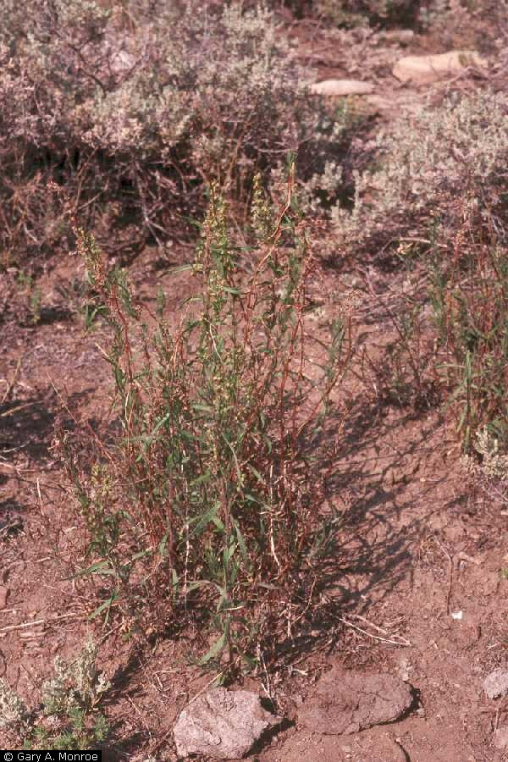
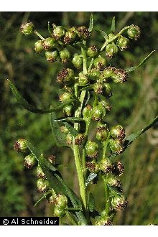
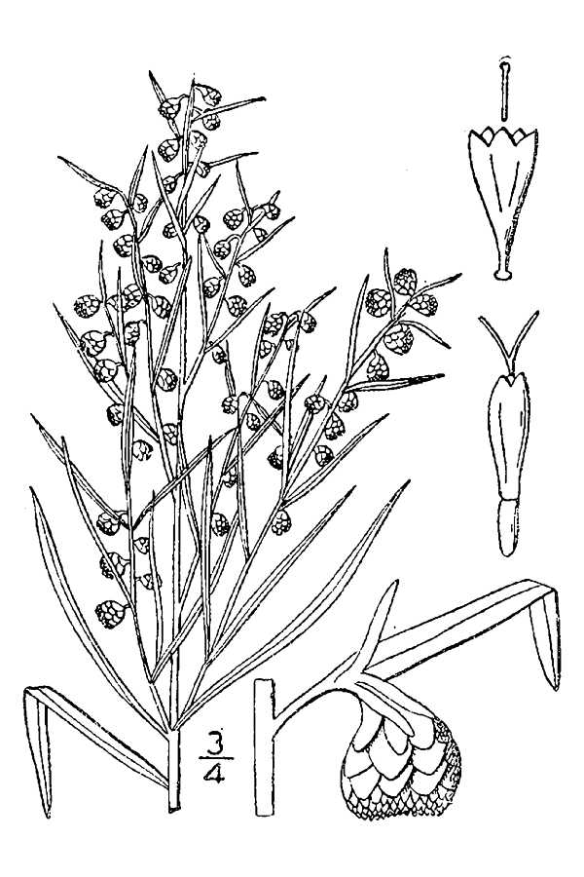
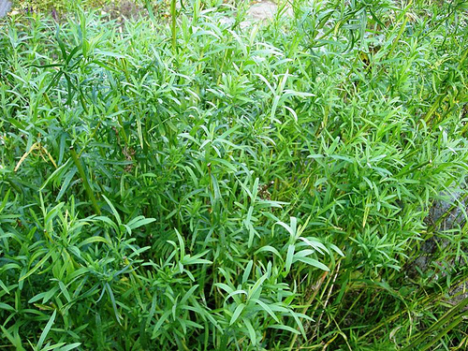
in the past only found in plot 29
ARDR – Artemisia dracunculus
tarragon sagewort

Slide 4
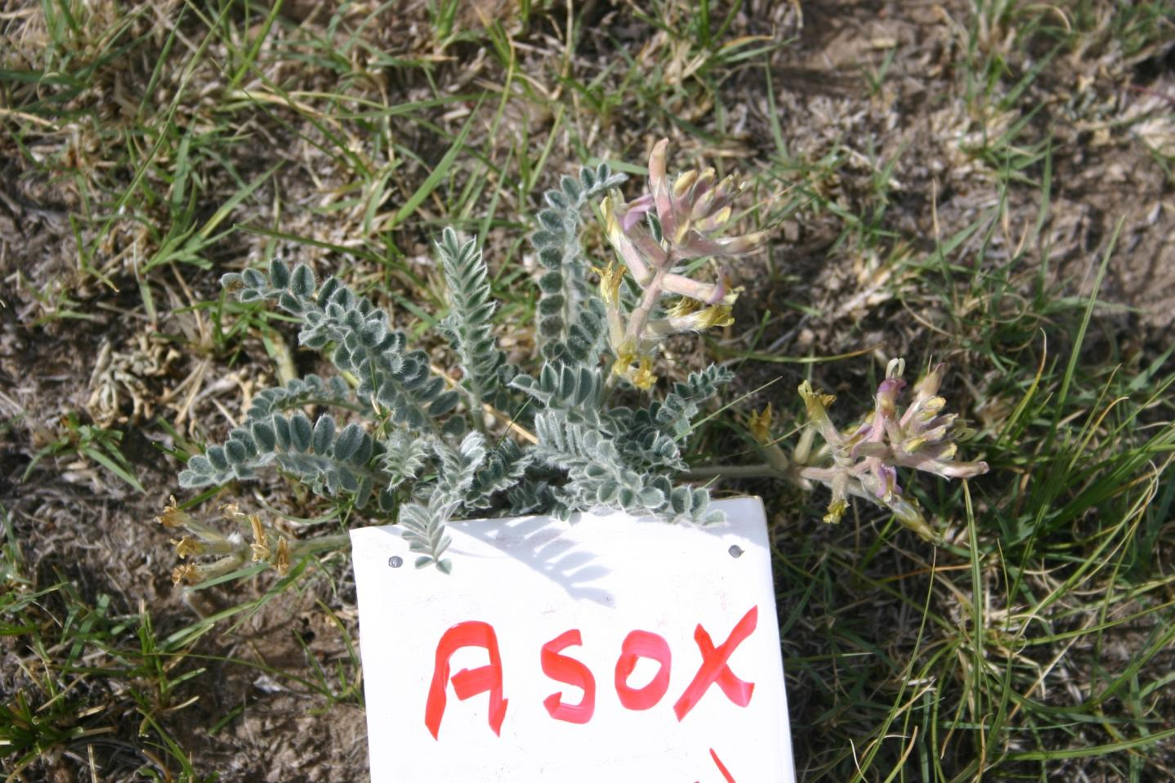
FORBS
Astragalus/Oxytropis
Milkvech and Locoweed families

Slide 5
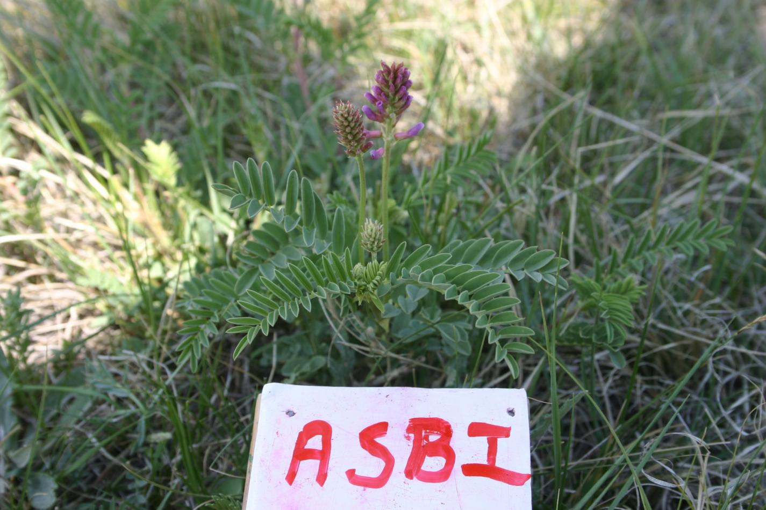
FORBS
Astragalus spp.
ASOX

Slide 6
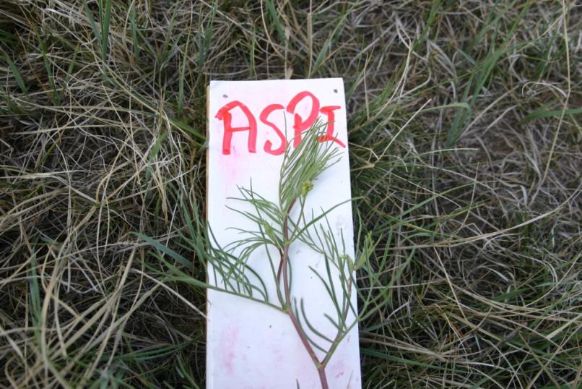
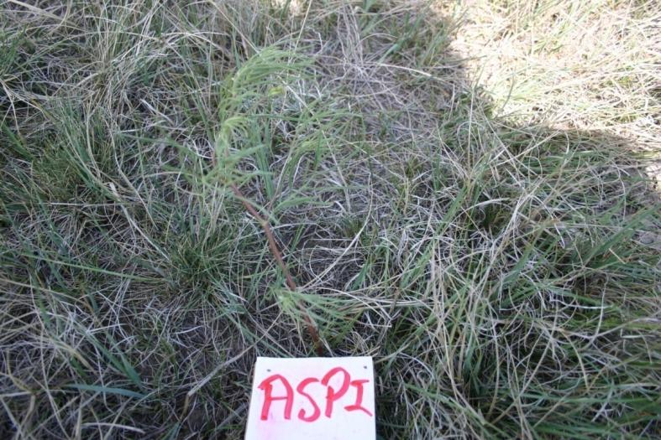
FORBS
Astragalus pectinatus

Slide 7
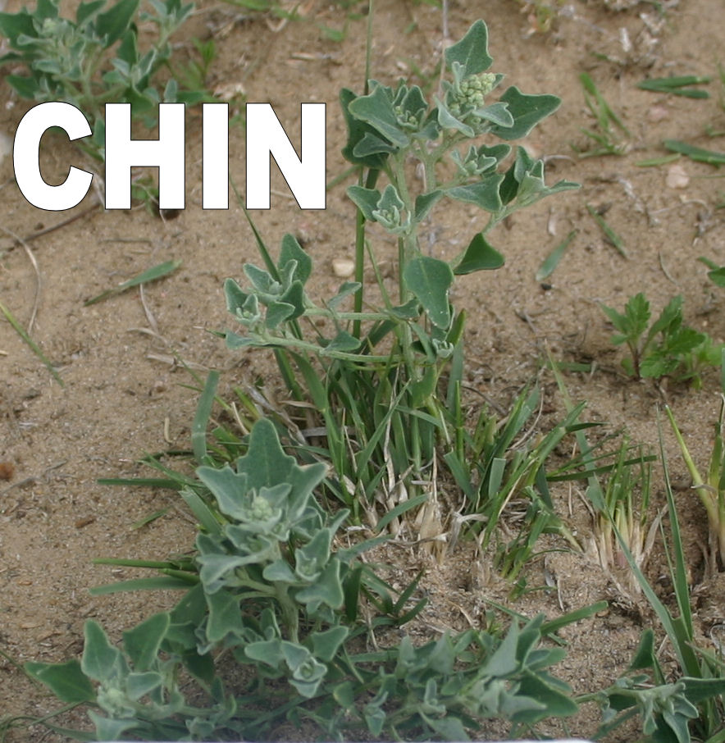
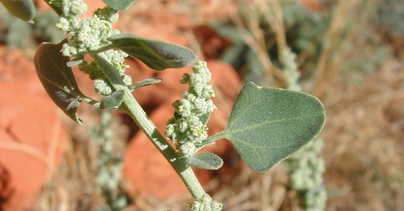
FORBS
Chenopodium incanum
mealy goosefoot

Slide 8
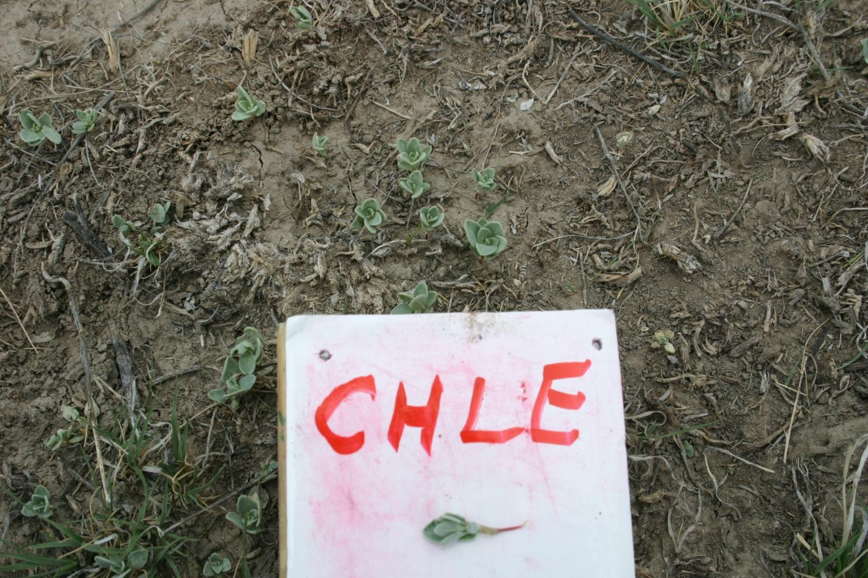
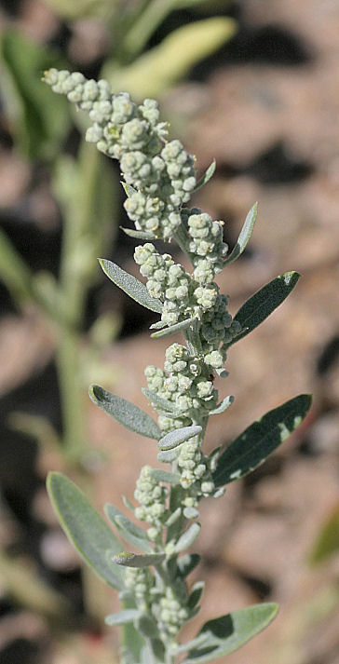
FORBS
Chenopodium leptophyllum
Narrowleaf goosefoot
Notes:
Long skinny leaves (seen in the photo at the right)

Slide 9
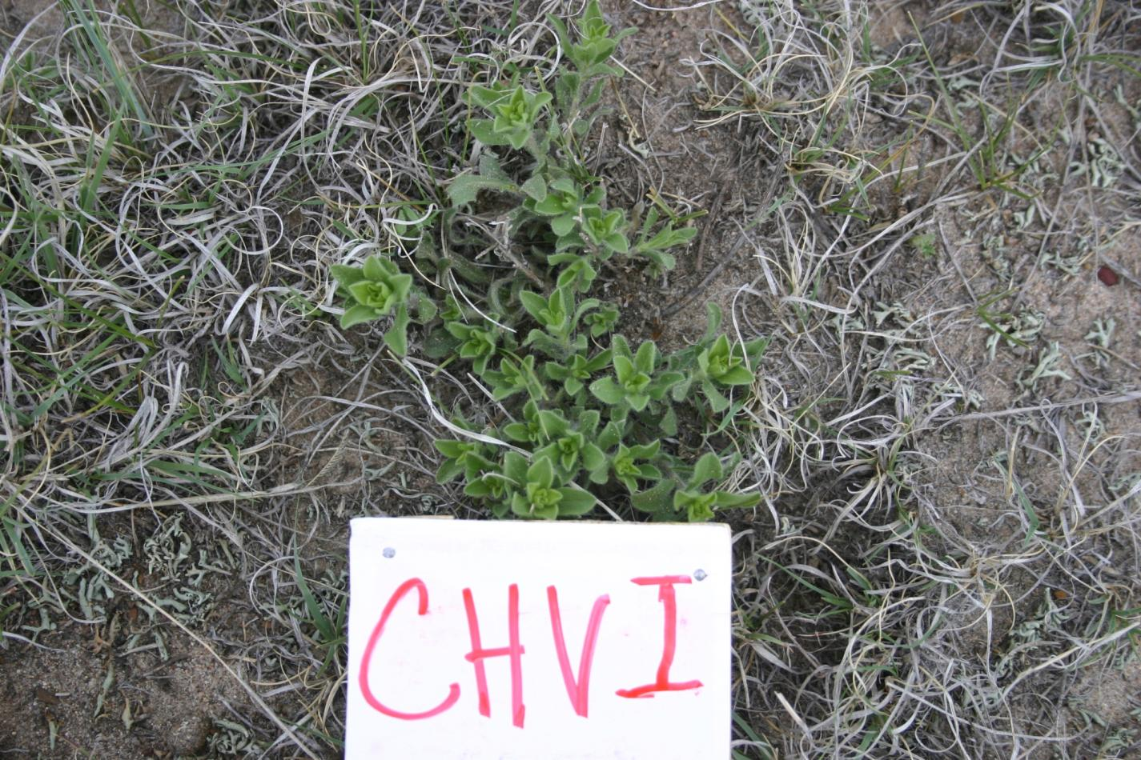
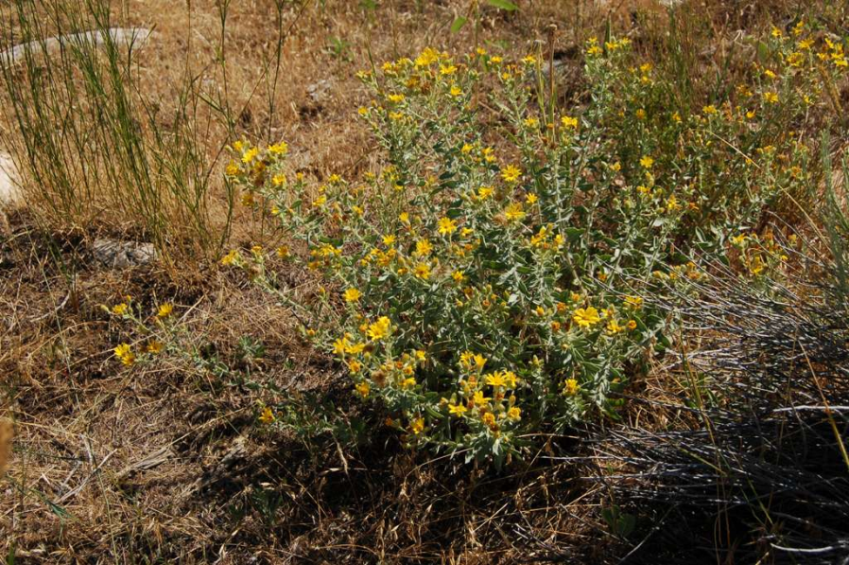
FORBS
Heterotheca villosa
hairy goldenaster
HEVI
Notes:
Yellow flowers; Hairy Goldenaster

Slide 10
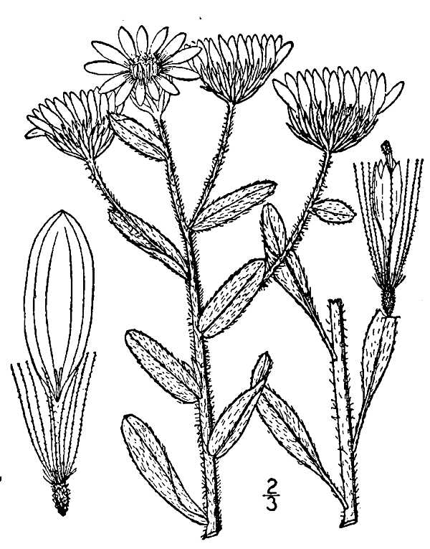
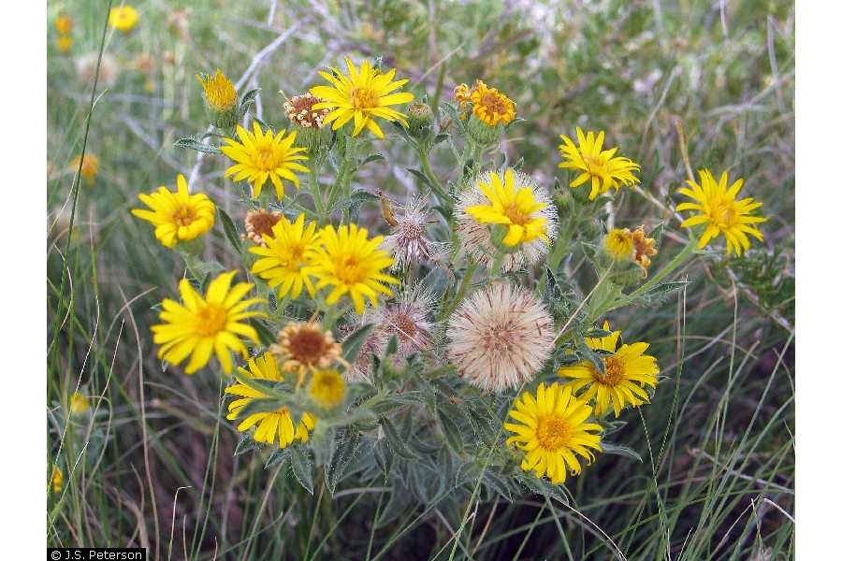
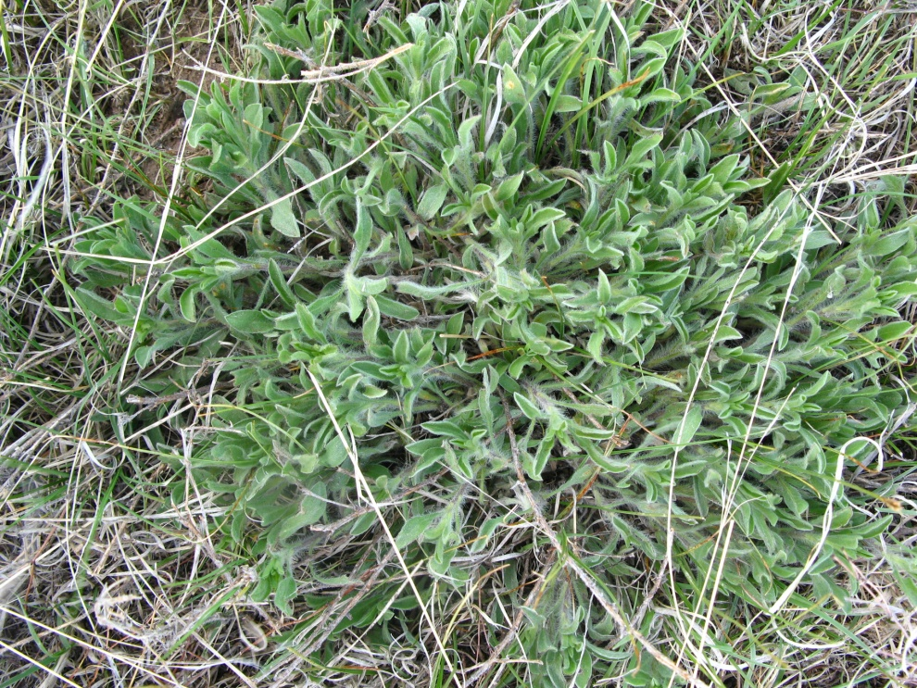
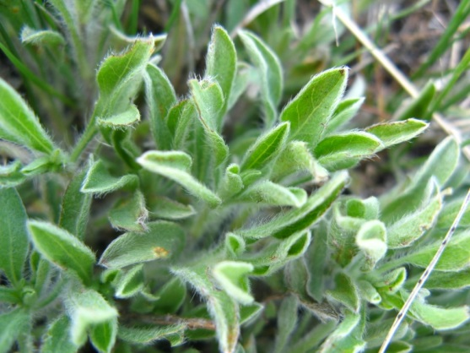
very fuzzy, sweet smell, grows in low patches,
HEVI –Heterotheca villosa

Slide 11
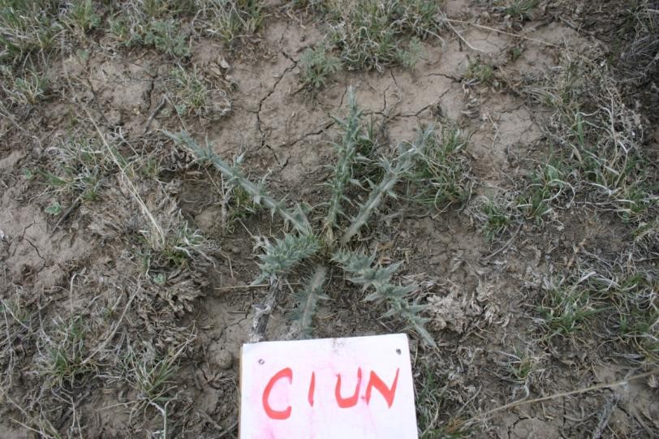
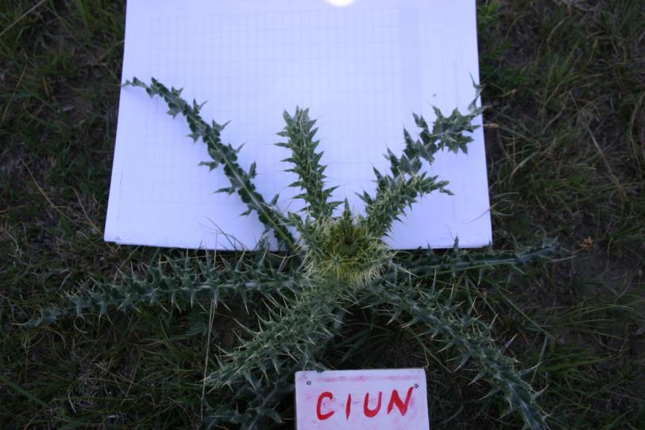
FORBS
Cirsium undulatum

Slide 12
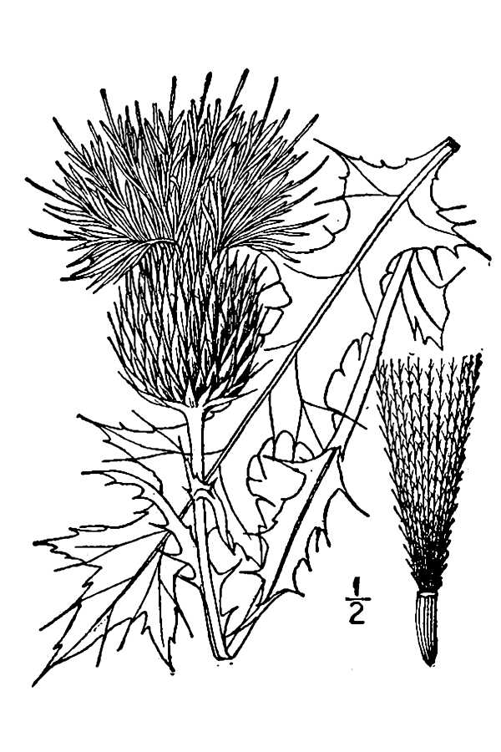
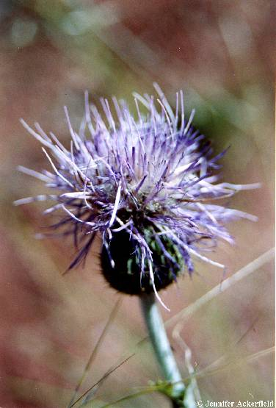
the only thistle in PHACE plots
CIUN – Cirium undulatum – wavy-leaved thistle

Slide 13
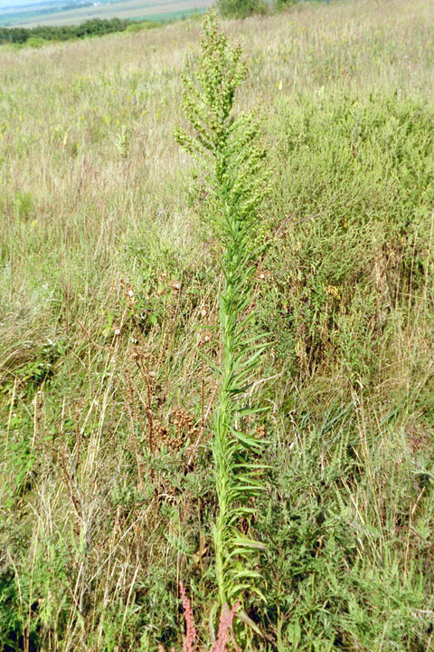
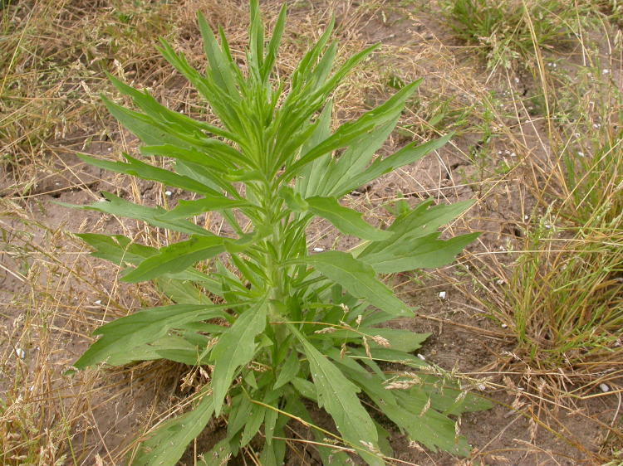
FORBS
Conyza canadensis
horseweed or marestail

Slide 14
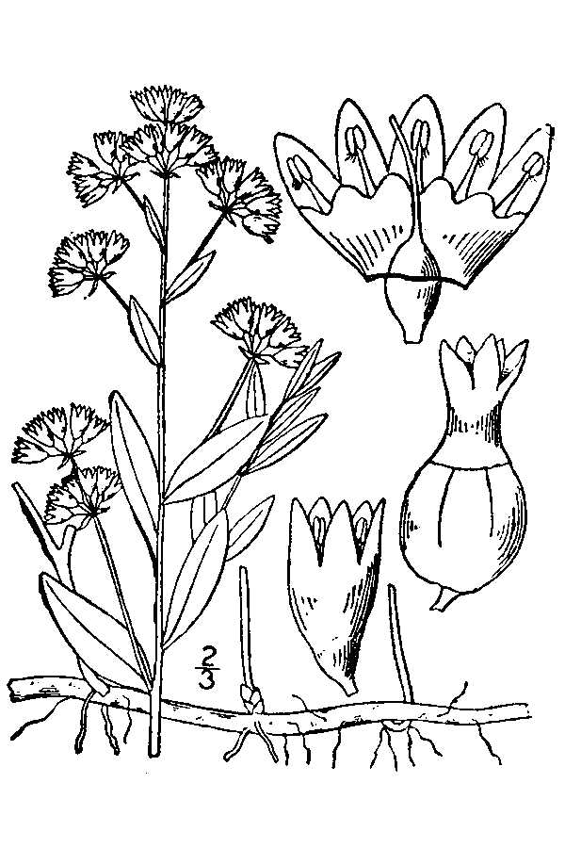
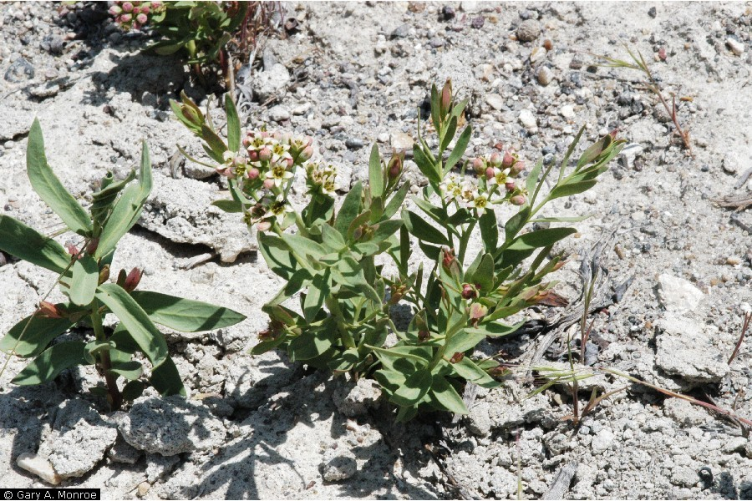
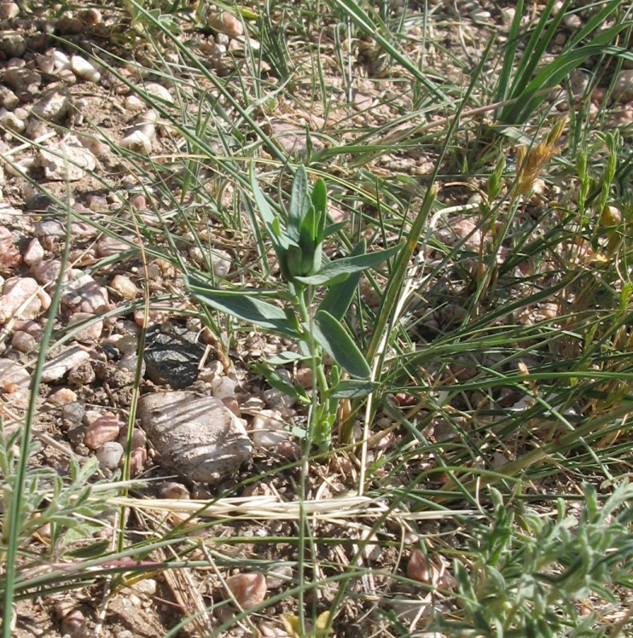
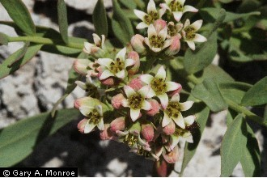
Leaf margins smooth, unlike GACO.
COUM – Comandra umbellata – bastard toadflax

Slide 15
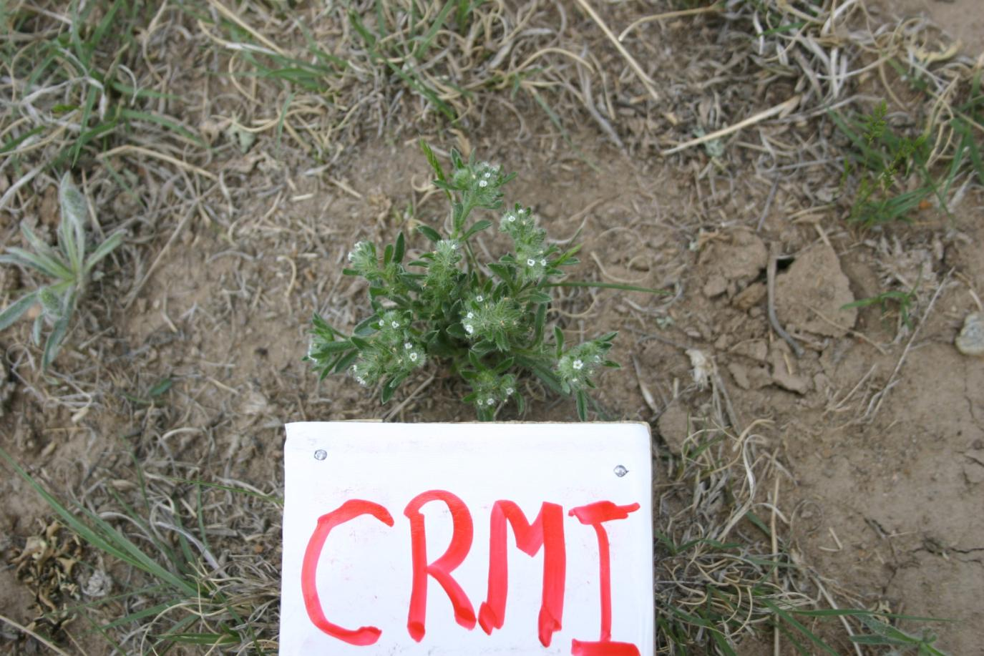
FORBS
Cryptantha minima
plains cryptantha

Slide 16
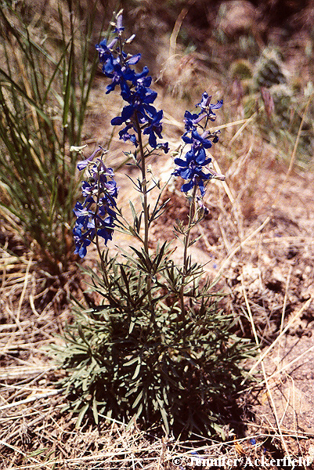
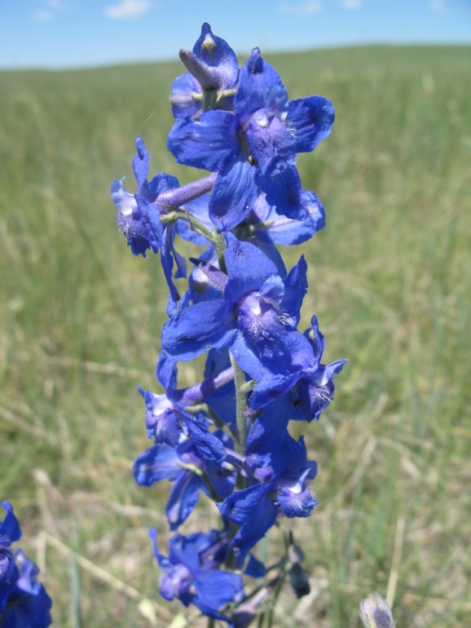
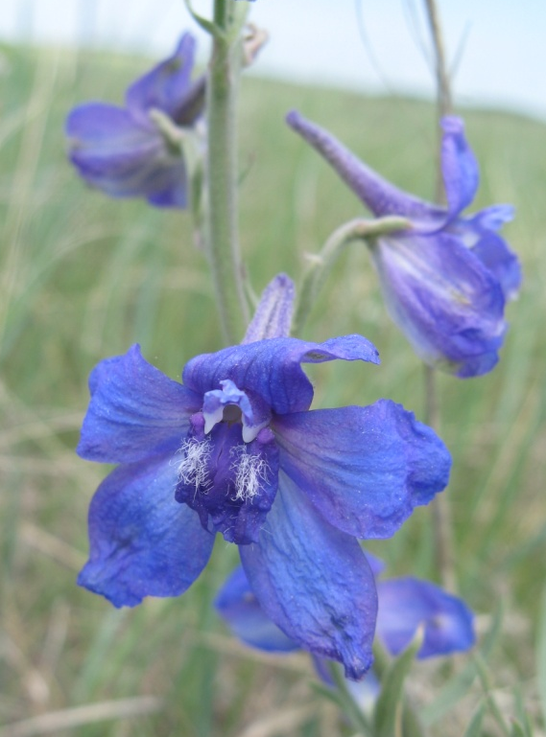
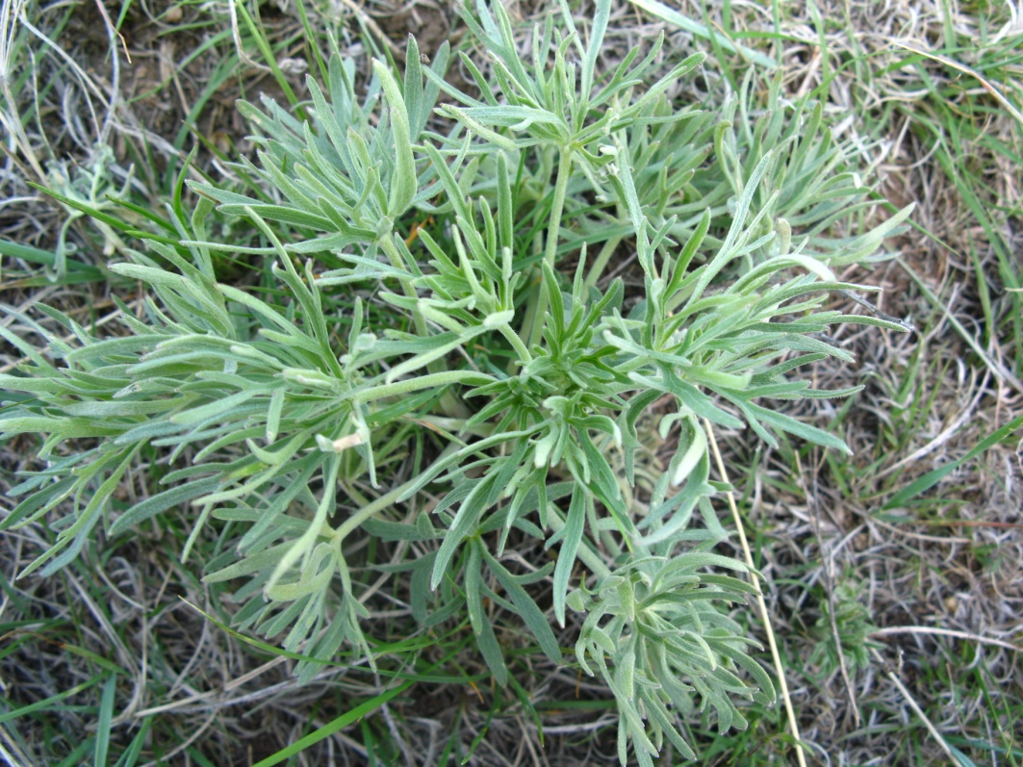
extremely divided-palmate leaves;
DEGE – Delphinium geyeri - larkspur

Slide 17
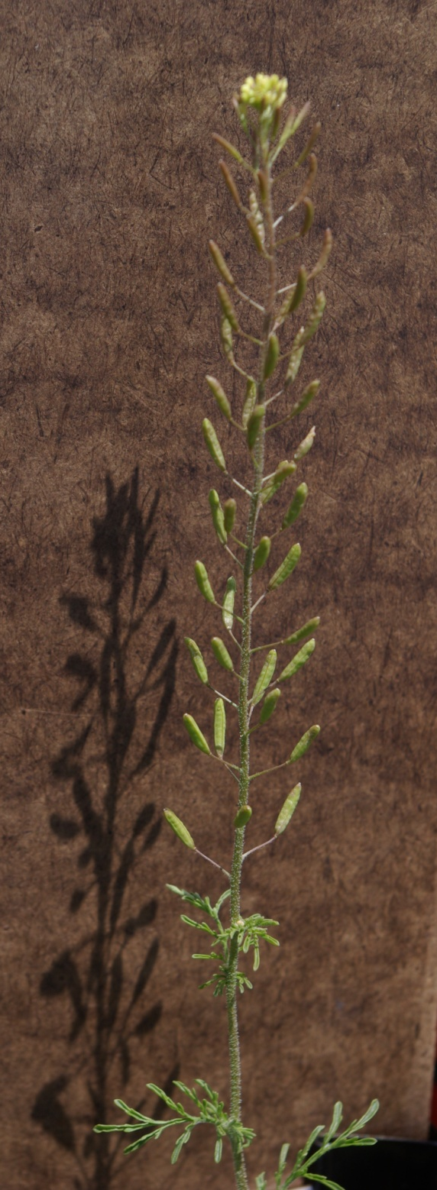
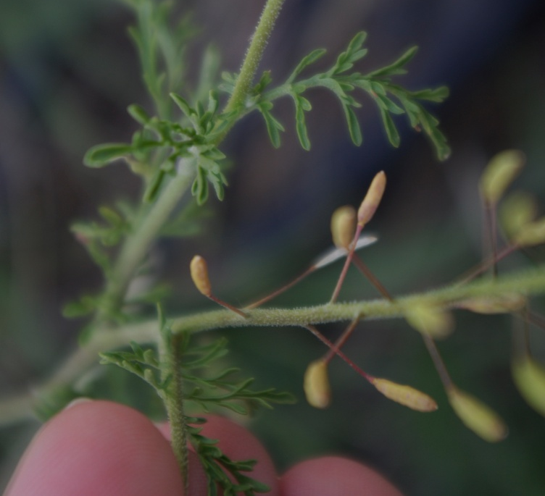
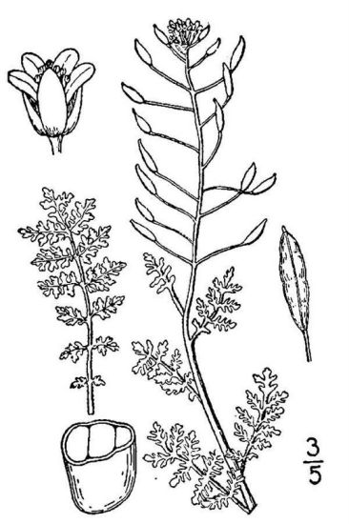
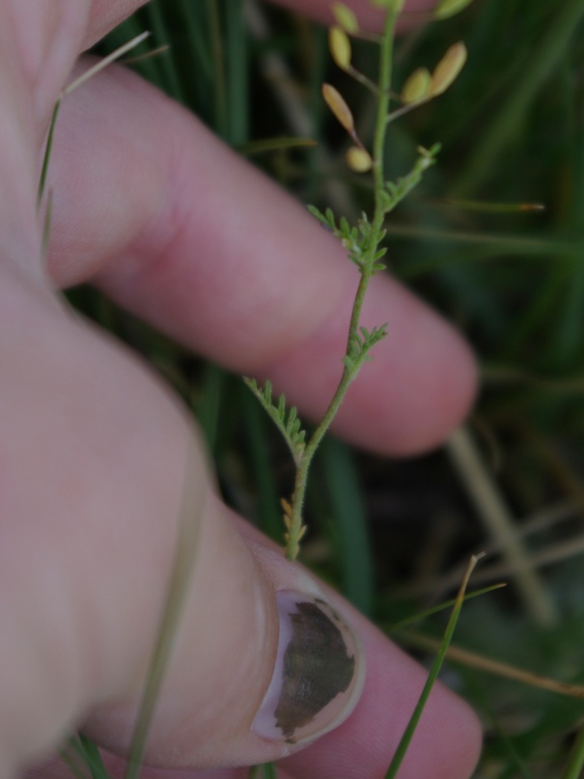
note unique seed pods; DEPI has more
oblong pods than DESO which has long,
thin pods.
DEPI – Descurainia pinnata – tansy-mustard

Slide 18
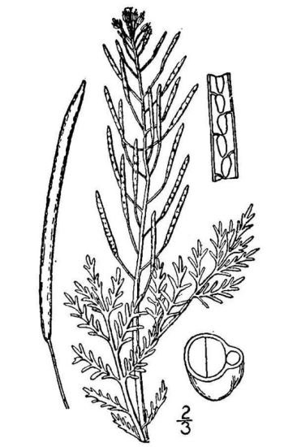
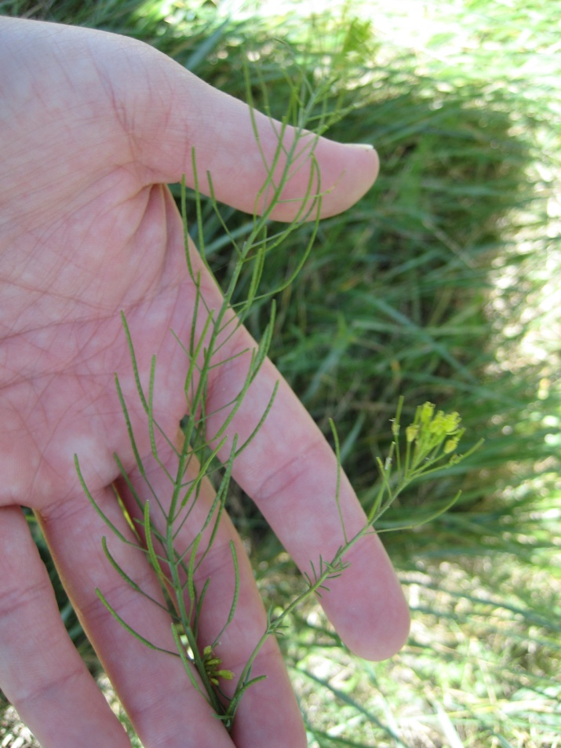
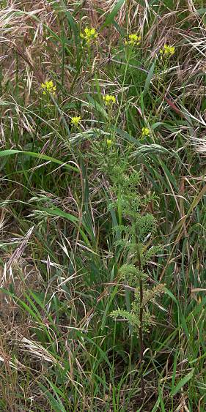
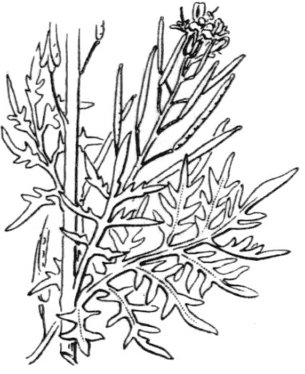
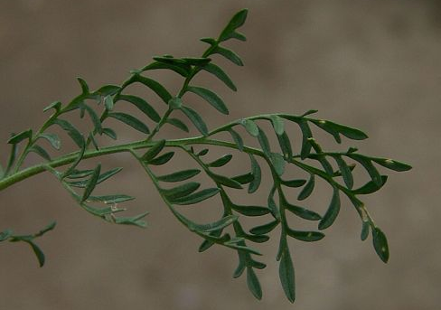
long and thin seed pods
DESO – Descurainia sophia – tansy mustard

Slide 19
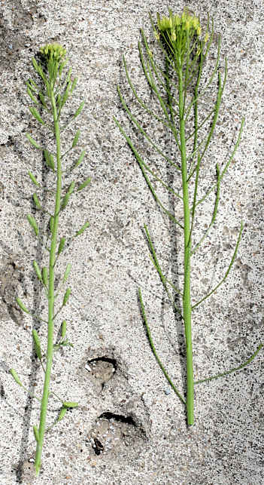
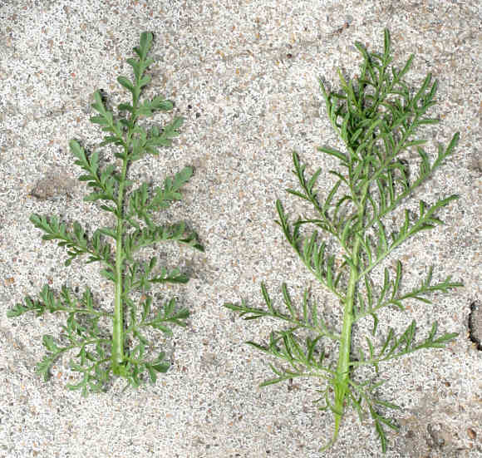
Fruits of D. pinnata are clubbed shaped (left) while D. sophia are linear shaped (right)
Leaves of D. pinnata have wider divisions (left) while D. sophia the divisions are narrower (right).
DEPI VS. DESO

Slide 20
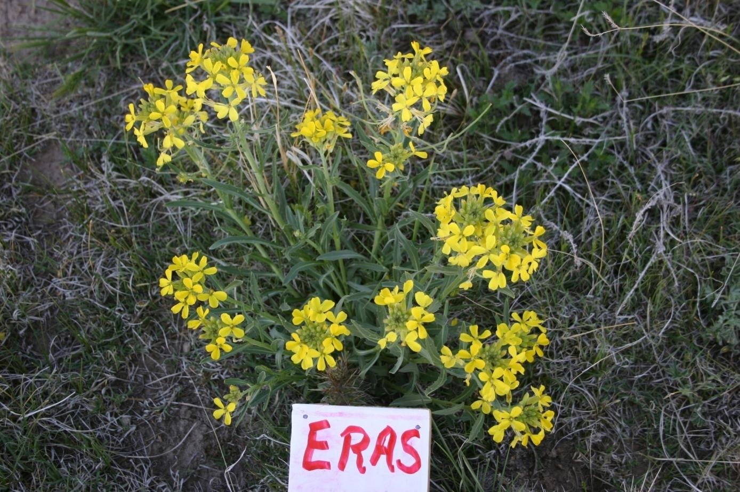
FORBS
Erysimum asperum
western wallflower

Slide 21
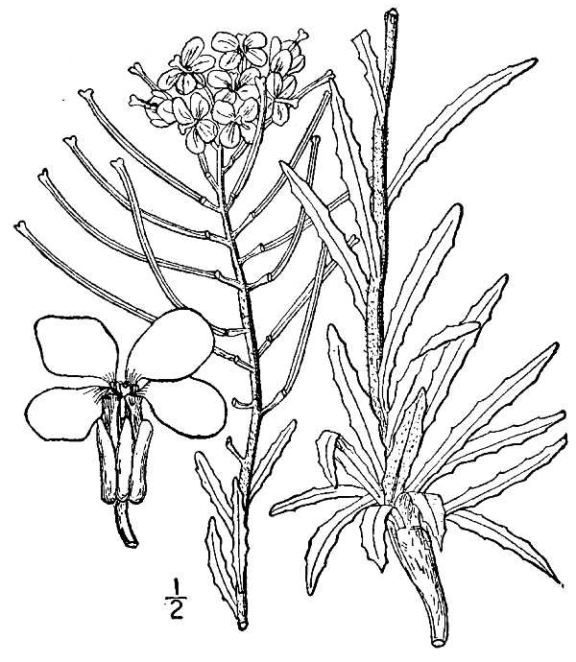
note ‘wavy’ leaf margins, cruciferus flower and
seed pods; lvs much longer than GACO and less
“waxy” than PEAL.
ERAS - Erysimum asperum

Slide 22
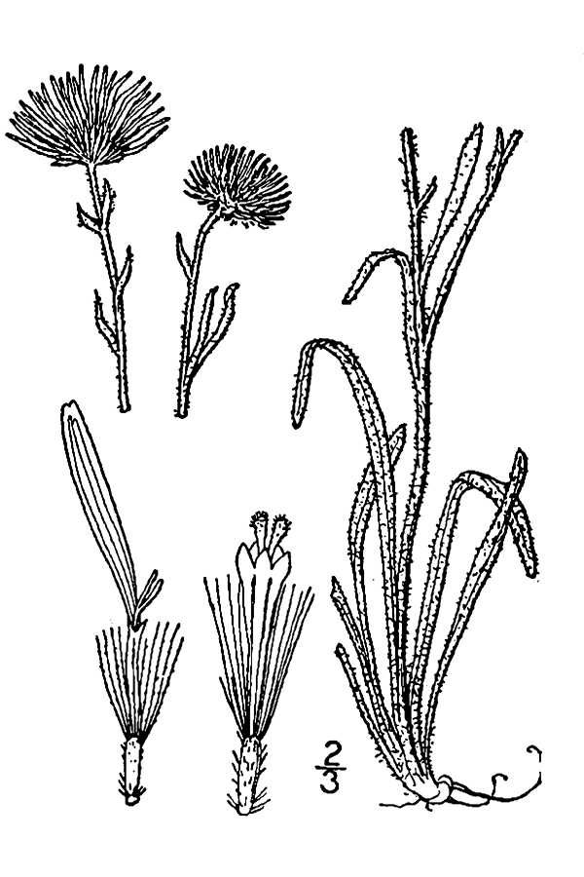
very fuzzy, lvs mostly basal; white-daisy-like
flower; longer leaves than CHVI; found in most
PHACE plots; much more common than CRTH .
ERPU - Erigeron pumilus – hairy fleabane

Slide 23
FORBS
Euphorbia glyptosperma
ridgeseed euphorbia

Slide 24
FORBS
Evolvulus nuttallianus
Nuttal’s evolvulus
EVNU

Slide 25
FORBS
Gaura coccinea
scarlet guara

Slide 26
usually a small, single stemmed plant; leaf margins
with small ‘tooths’, unique ‘orchid-like’ flower;
confused with COUM and young LIDA, but those
have smooth leaf margins and lvs are thicker.
GACO – Gaura coccinea

Slide 27
GRSQ – Grindlia squarrosa – curlycup gumweed

Slide 28
extremely divided leaves; confused for ARFR but
is not really ‘fuzzy’; just extremely divided
and no sage smell.
HASP – Haplopappus spinulosus – ironplant tansyaster

Slide 29
FORBS
Ipomopsis laxiflora
looseflowered gilia

Slide 30
FORBS
Iva axillaris
povertyweed
IVAX

Slide 31
FORBS
Kochia scoparia
burningbush

Slide 32
FORBS
Lappula redowskii
blueburr stickseed

Slide 33
FORBS
Lepidium densiflorum
prairie pepperweed

Slide 34
leaves look like GACO but ‘pepper-like’ seeds are diagnostic
LEDE – Lepidium densiflorum – prairie pepperweed

Slide 35
FORBS
Leucocrinum montanum
common starlily

Slide 36
LIIN (Lithospermum incisum)
FORBS
narrowleaf gromwell

Slide 37
FORBS
Lupinus pusillus
low lupine

Slide 38
FORBS
Lygodesmia juncea
rush skeletonweed

Slide 39
FORBS
Machaeranthera tanacetifolia
tansyleaf aster

Slide 40
FORBS
Melolotus officinalis
yellow sweetclover

Slide 41
FORBS
Mirabilis linearis
narrowleaf four o’clock
Long,
thin,
non-serrated
leaves

Slide 42
FORBS
Musieon divaricatum
leafy musineon
Notes:
CYAC species up at PHACE

Slide 43
FORBS
Oenothera albicaulis
prairie evening primrose

Slide 44
FORBS
Oenothera coronopifolia
coronopsus evening primrose

Slide 45
FORBS
Penstemon albidus
white penstemon
PEAL

Slide 46
“waxy-shiny” leaves; distinct flowers; was flowering in mid-june. Similar
Species with blue flowers = PEAN
PEAL – Penstemon albidus – white penstemon

Slide 47
Penstemon angustifolius
FORBS
narrowleaved penstemon

Slide 48
very low growing in tight clusters; “spiky” leaves;
flowers very early; confused with small HASP but
HASP has large & extremely divided leaves.
PHHO – Phlox hoodii – Hood’s phlox

Slide 49
FORBS
Picradeniopsis oppositifolia
plains bahia

Slide 50
FORBS
Plantago patagonica
wooly plantain

Slide 51
FORBS
Portulaca oleracea
common purslane

Slide 52
not easily confused with other species; very unique lvs.
POPE – Potentilla pensylvanica – Prairie cinquefoil

Slide 53
FORBS
Psoralea tenuiflorum
slimflower scurfpea

Slide 54
FORBS
Salsola iberica
Russian thistle

Slide 55
FORBS
Scutellaria brittonii
(blue/purple flowers)
Brittion's skullcup
SCBR

Slide 56
FORBS
Senecio tridenticulatus
prairie groundsel

Slide 57
basal leaves large and
deeply lobed; long-thin seed pods. Confused
with DESO and DEPI.
SIAL – Sisymbriun altissimum –tumble hedgemustard

Slide 58
FORBS
Sphaeralcea coccinea
scarlet globemallow

Slide 59
FORBS
Thelesperma filifolium
threadleaf greenthread

Slide 60
FORBS
Tragopogon dubius
western salsify

Slide 61
long narrow leaves with prominent mid-vein; confused with
LEMO but TRDU can have a real stem and grow taller;
TRDU typically shows white sap at leaf axils, very different
flowers
TRDU – Tragopogon dubius – western salsify

Slide 62
FORBS
Tradescantia occidenalis
priarie spiderwort

Slide 63
FORBS
Tripterocalyx micranthus
TRMI

Slide 64
FORBS
Verbena bracteata
(purple flowers)
bigbract verbena

Slide 65
CACTUS
Coryphantha vivipara
pincushion cactus
Notes:
Alternating spines

Slide 66
CACTUS
Echinocereus viridiflorus
barrel cactus
Notes:
Spines arranged in rows

Slide 67
FORBS
Opuntia polyacantha
plains prickly pear
Notes:
LOTS OF THESE!! Wear good boots!

